Slide 1
Home Page

Slide 2




Houghton Lake Bobcat Boosters
We are here for the student Athletes of Houghton Lake Community Schools
Sign your student up today!
Create your parent profile
Create your student profile for each child
Start Enrolling!

Slide 3
Create your parent profile
Create your student profile for each child
Start Enrolling!
It’s as EASY as 1, 2, 3!
Sports
Events
Donate
Sponsors
Houghton Lake Bobcat Boosters

Slide 4
Interaction

Slide 5

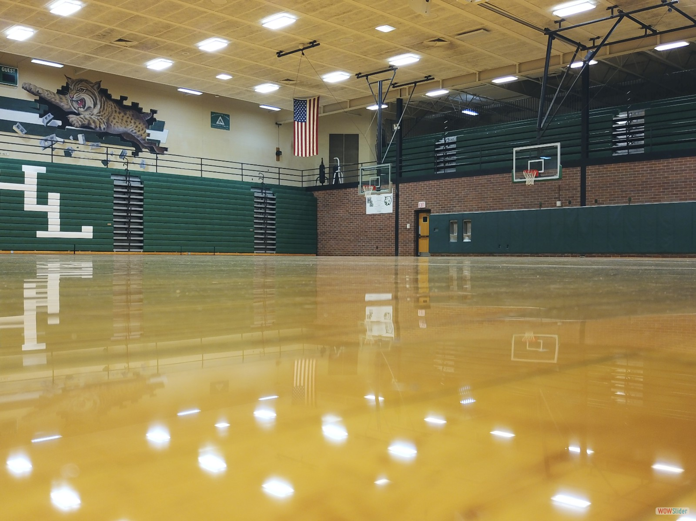
Houghton Lake Bobcat Boosters
About Bobcat Boosters
Sign in/Register
Sports + Pricing
Events
Donate
Fundraisers
Contact Us
Our Sponsors
We are here for the student Athletes of Houghton Lake Community Schools
Sign your student up today!
Create your parent profile
Create your student profile for each child
Start Enrolling!

Slide 6
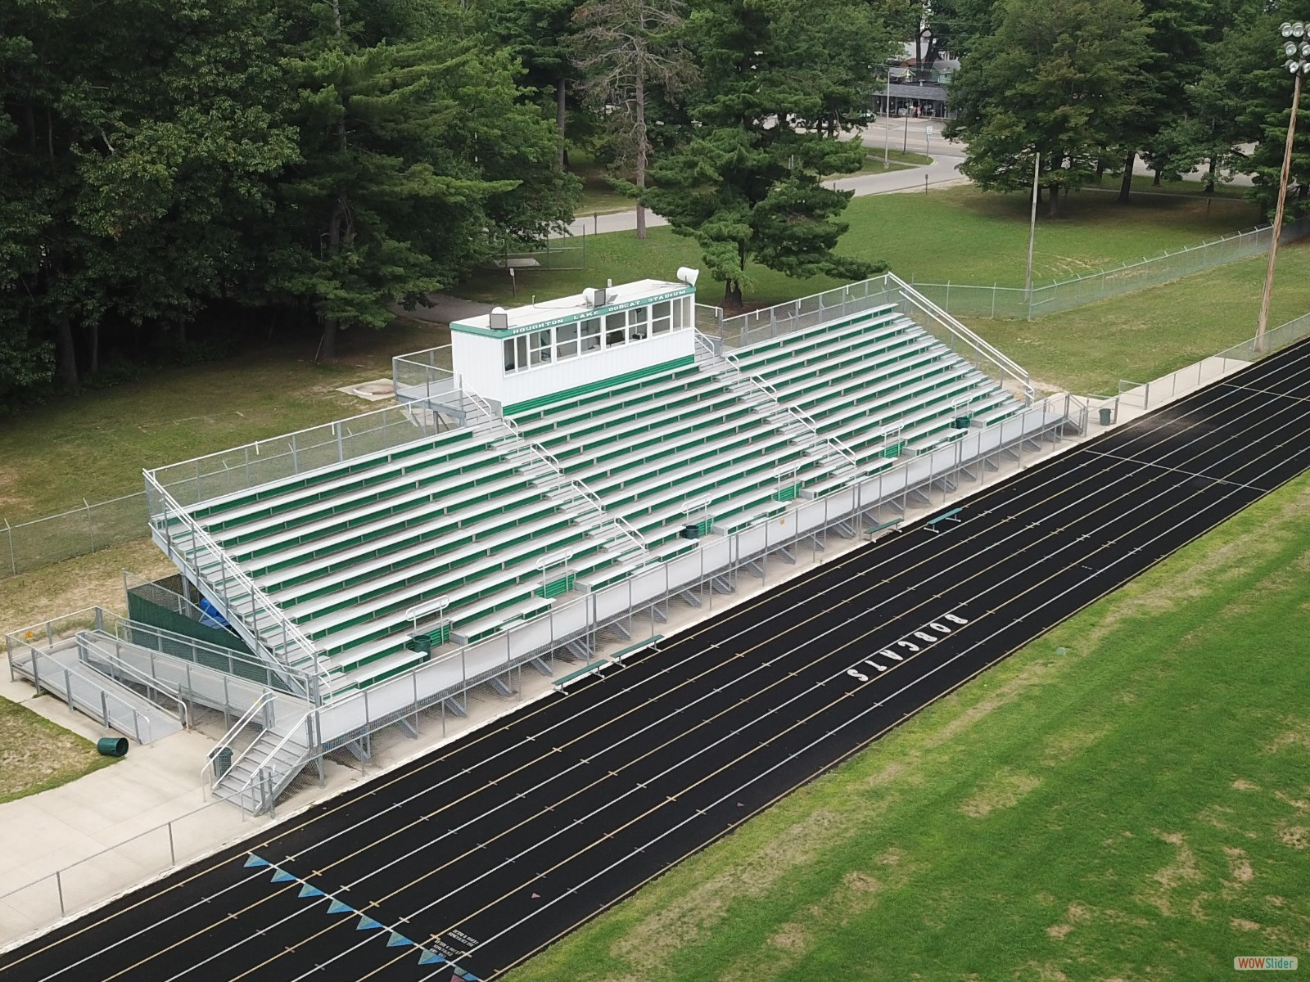
Houghton Lake Bobcat Boosters
About Bobcat Boosters
Sign in/Register
Sports + Pricing
Events
Donate
Fundraisers
Contact Us
Our Sponsors
We are here for the student Athletes of Houghton Lake Community Schools
Sign your student up today!
Create your parent profile
Create your student profile for each child
Start Enrolling!

Slide 7
Sign in/Register

Slide 8
Houghton Lake Bobcat Boosters
Returning Parent?
New Parent?
Sign in
Register
E-mail
E-mail
Password
Confirm E-mail
Password
Submit
?
Confirm Password
Submit
Houghton Lake Bobcat Boosters

Slide 9
Houghton Lake Bobcat Boosters
Returning Parent?
New Parent?
Sign in
Register
E-mail
E-mail
Password
Confirm E-mail
Password
Submit
?
CaSe SeNsItIvE
Password Requirements:
Must be 8-15 characters
Must have at least 1 number
Must have at least 1 capital letter
Confirm Password
Submit
Houghton Lake Bobcat Boosters

Slide 10
Profile
What you see when you sign in

Slide 11

Houghton Lake Bobcat Boosters
Welcome, Kimberly!
Your Information
Add a child
Name
Children
Kimberly S. Napierski
Hollie
Phone Number
Elizabeth
(989) 422-6083
Enroll in sports
Address
Fundraisers
201 Ferris St.
Houghton Lake, MI 48629
Other information
Emergency Contact
Edward J. Napierski
(248) 361-1568
Houghton Lake Bobcat Boosters

Slide 12
Houghton Lake Bobcat Boosters
Welcome, Kimberly!
Elizabeth’s Information
Add a child
Name
Children
Elizabeth L. Napierski
Hollie
Phone Number
Elizabeth
Same as parent
Address
Enroll in sports
Same as Parent
Fundraisers
Birthdate
09/19/1995
Allergies
Penicillin
Date of last physical
?
08/24/2012
Health Insurance information
MI Healthy Kids
123-456-7890

Slide 13
Interaction

Slide 14
Houghton Lake Bobcat Boosters
Profile
Welcome, Kimberly!
Enroll in Sports
Your Information
Events
Add a child
Fundraisers
Name
Make a payment
Children
Kimberly S. Napierski
Hollie
Phone Number
(989) 422-6083
Contact Us
Elizabeth
Address
Sign out
Enroll in sports
Fundraisers
201 Ferris St.
Houghton Lake, MI 48629
Other information
Emergency Contact
Edward J. Napierski
(248) 361-1568
Houghton Lake Bobcat Boosters

Slide 15
Houghton Lake Bobcat Boosters
Profile
Welcome, Kimberly!
Profile
Enroll in Sports
Enroll in Sports
Your Information
Events
Add a child
Events
Fundraisers
Name
!
Make a payment
Fundraisers
Children
Kimberly S. Napierski
Hollie
Phone Number
Make a payment
(989) 422-6083
Contact Us
Elizabeth
Address
Sign out
Enroll in sports
Contact Us
Fundraisers
201 Ferris St.
Houghton Lake, MI 48629
Sign out
Other information
Emergency Contact
Edward J. Napierski
(248) 361-1568
Houghton Lake Bobcat Boosters

Slide 16
Add a child
Elizabeth’s Information
Name
Children
Elizabeth L. Napierski
Hollie
Phone Number
Elizabeth
Same as parent
Enroll in sports
Address
Same as Parent
Fundraisers
Birthdate
09/19/1995
Allergies
Penicillin
Date of last physical
?
08/24/2012
This is so we can alert you when the physical needs to be updated.
This date does not verify the physical.
The physical needs to be turned in to the school’s administration
Health Insurance information
MI Healthy Kids
123-456-7890
Other information
Emergency Contact
Same as parent
Houghton Lake Bobcat Boosters

Slide 17
Add a child
Elizabeth’s Information
Name
Children
Elizabeth L. Napierski
Hollie
Phone Number
Elizabeth
Same as parent
Enroll in sports
Address
Same as Parent
Fundraisers
Birthdate
09/19/1995
Allergies
Penicillin
Date of last physical
08/24/2012
?
Health Insurance information
MI Healthy Kids
123-456-7890
Other information
Emergency Contact
Same as parent
Houghton Lake Bobcat Boosters

Slide 18
Enroll in Sports

Slide 19
Houghton Lake Bobcat Boosters
Enroll in Sports
Choose Child/Children
Hollie
Elizabeth
Choose Sport
Football
Softball
Competitive Cheer
Basketball
Baseball
Football Cheer
Soccer
Track
Volleyball
Choose Season
School Year
Season
Submit
Submit + Make Payment
Cancel
Houghton Lake Bobcat Boosters

Slide 20
Events

Slide 21
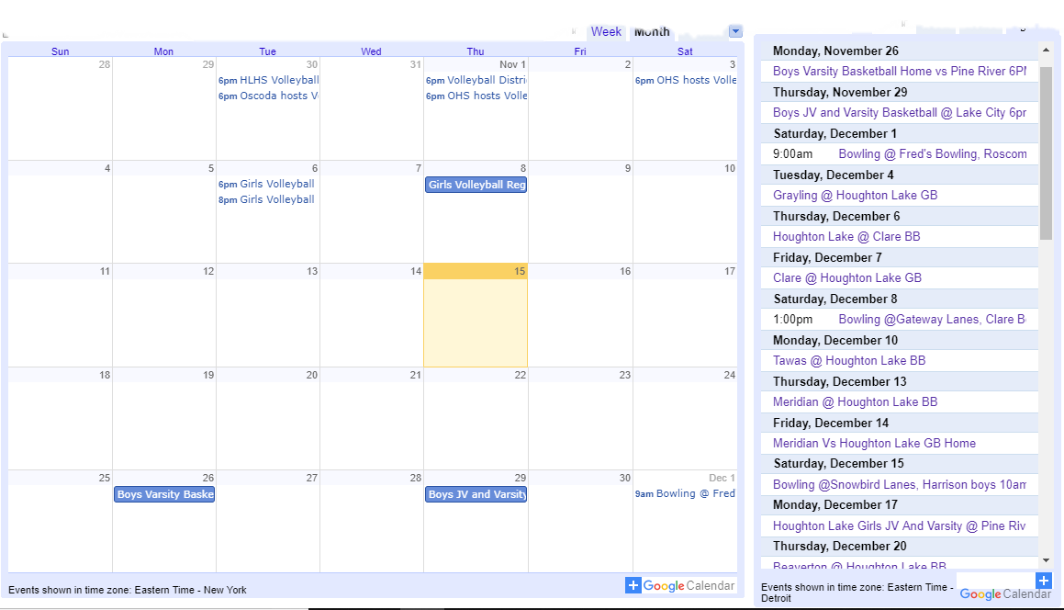
Houghton Lake Bobcat Boosters
Events
Houghton Lake Bobcat Boosters

